Slide 1
AAM INFOTECH
Industrial Training
Submitted To :- Submitted By:-
Shravan Kumar Sachin
Atul kumar
CSE 8th (SEM)

Slide 2
INTRODUCTION
Voice command song downloading App is a quiz app to create a quiz.
It is based upon the Python .
Python -Python is an interpreted high-level general-purpose programming language. Python's design philosophy emphasizes code readability with its notable use of significant indentation

Slide 3
System Specification
HARDWARE REQUIREMENTS :
Processors: Intel Atom® processor or Intel® Core™ i5 processor.
RAM: At least 1GB
SOFTWARE REQUIREMENTS:
Operating Systems: Windows 7or later.
Front-End : python

Slide 4
Reqired modules to install
beautifulsoup4==4.9.1
bs4==0.0.1
certifi==2020.6.20
chardet==3.0.4
comtypes==1.1.8
googlesearch-python==2020.0.2
html5lib==1.1
idna==2.10
pafy==0.5.5
pypiwin32==223
pyttsx3==2.90
pywin32==300
requests==2.24.0
six==1.15.0
soupsieve==2.0.1
SpeechRecognition==3.8.1
urllib3==1.25.9
webencodings==0.5.1
youtube-dl==2021.1.8

Slide 5
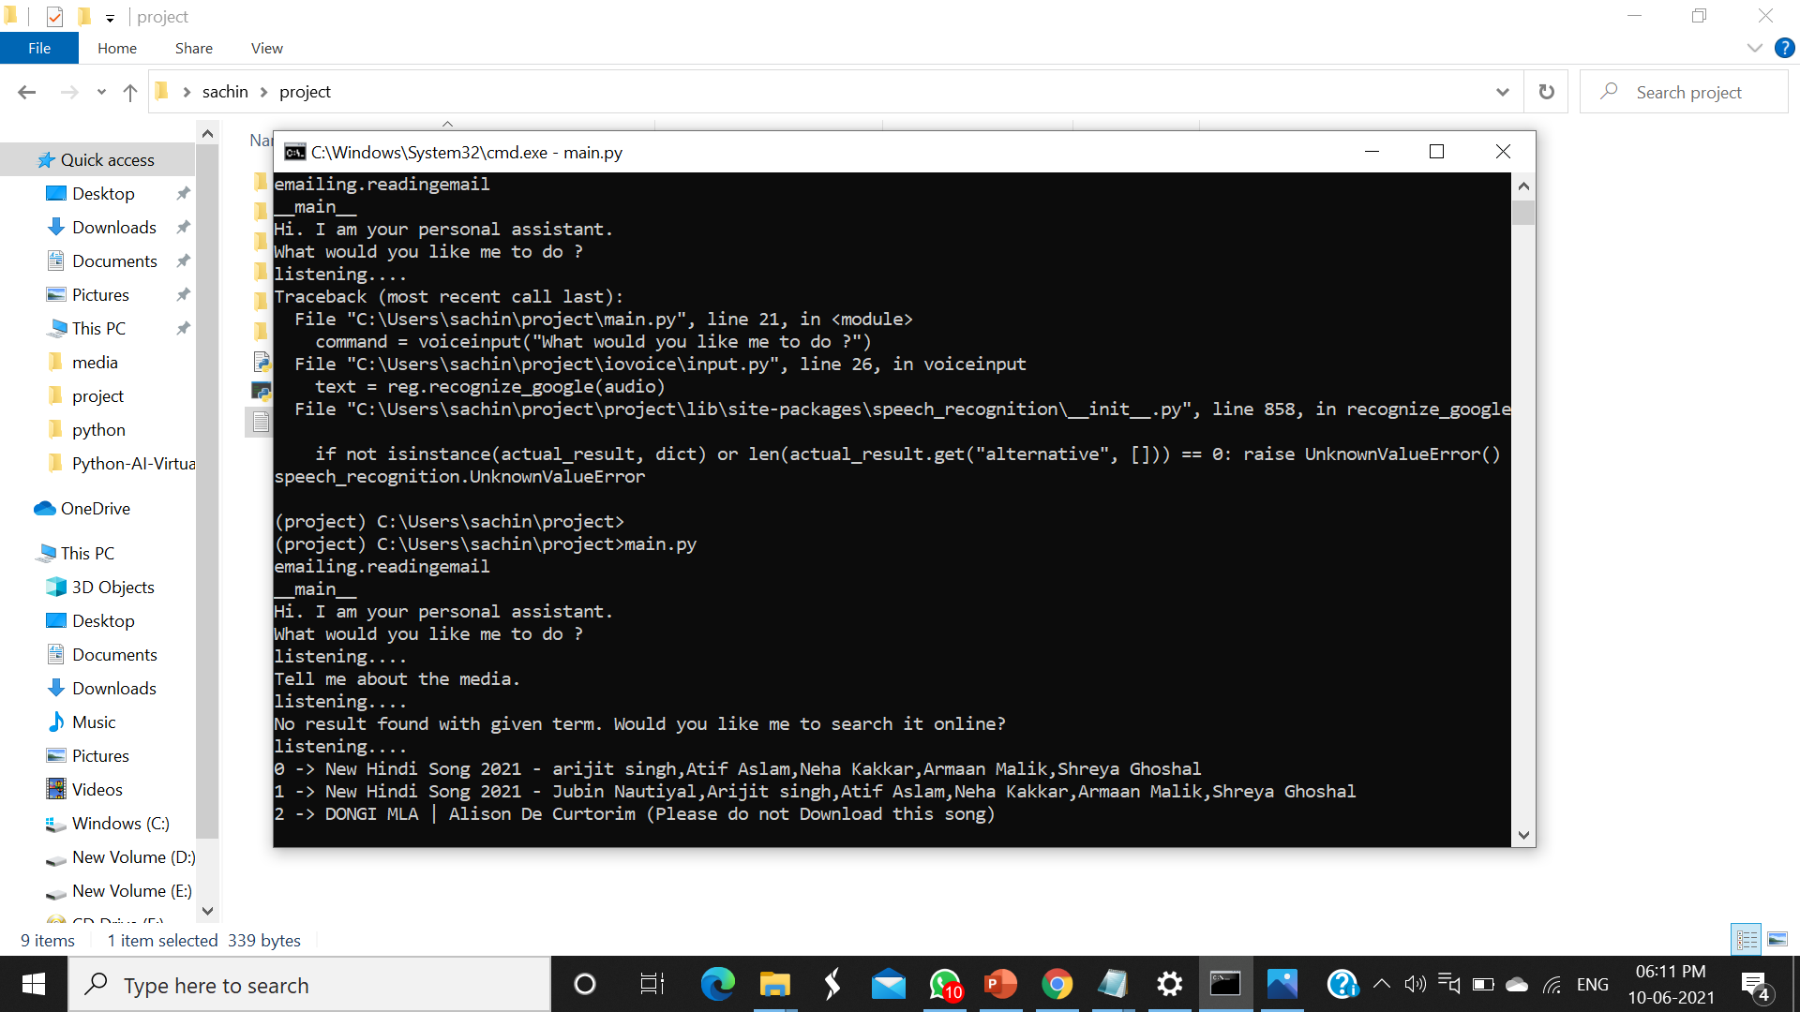
Project Snapshots

Slide 6
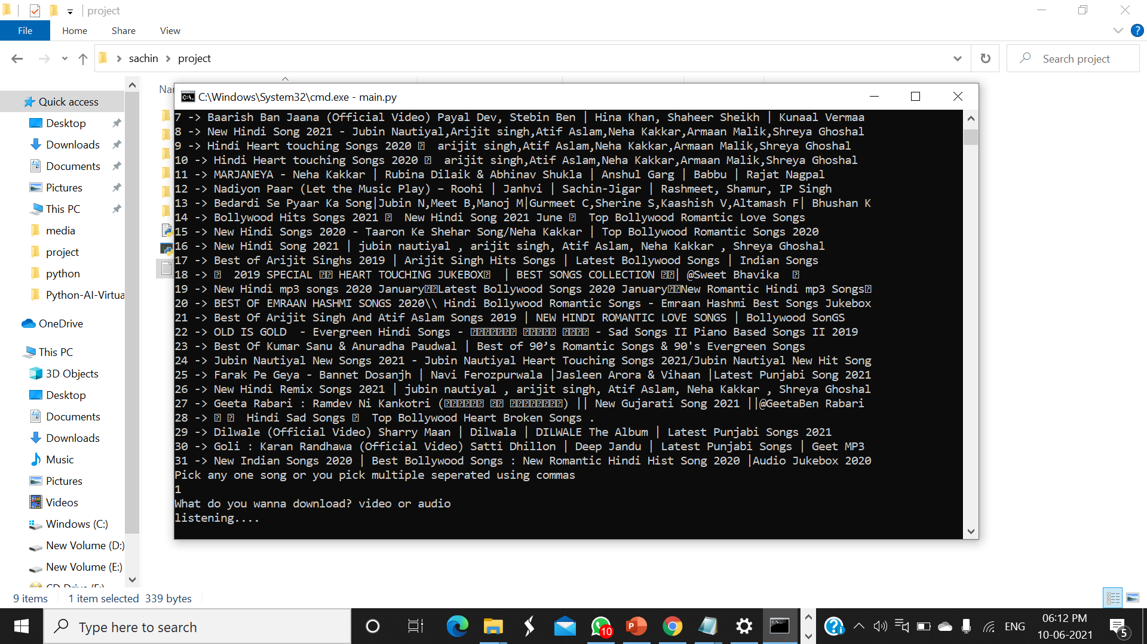

Slide 8
Thank You

